Slide 1
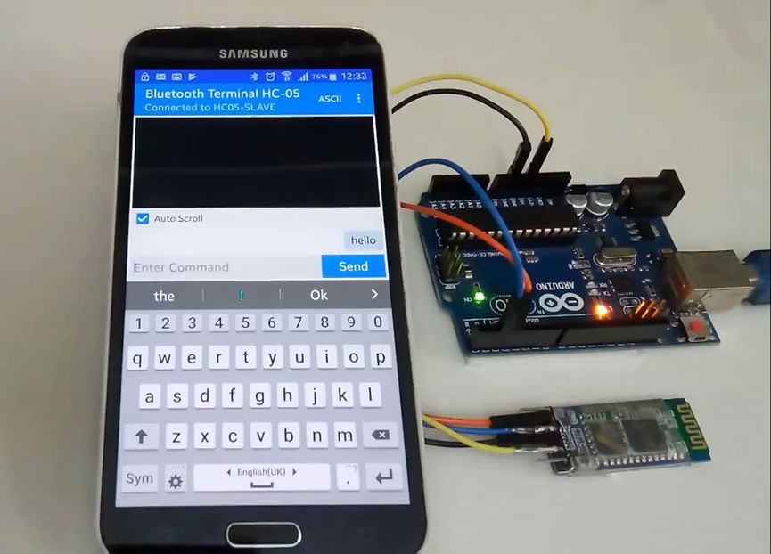
(Permanently Affiliated to University of Mumbai)
CHILD SAFETY DEVICE

Slide 2
(Permanently Affiliated to University of Mumbai)
PREPARED BY:
Lajree Lohar
Gandhali Malve
Tanay Malviya
(Students)
GUIDED BY:
Pro. Swapnil Gharat

Slide 3
(Permanently Affiliated to University of Mumbai)
INTRODUCTION
The application is used by parents to keep their child safe. The proposed work will monitor the child until it connected to the parent with the use of an android phone and Bluetooth device. The android phone will be with the parents which includes the application and the Bluetooth device will be put firm with the child. An alarm will be there with the parents which will ring when the child goes out of the range.
Bluetooth system search for the connection with child’s device and send alert message to the parent. If embedded Bluetooth is disconnected and it send alert message and call to the register mobile number. Our system consists of children security system . This makes secure safety for children.

Slide 4
(Permanently Affiliated to University of Mumbai)
OBJECTIVES:
The main goal of our project is to preserve the security of children, to serve our purpose we are developing Wireless portable safety device.
Bluetooth system search for the connection with child’s device and send alert message to the parent.
If embedded Bluetooth is disconnected and it send alert message and call to the register mobile number.
Our system consists of children security system . This makes secure safety for children.

Slide 5
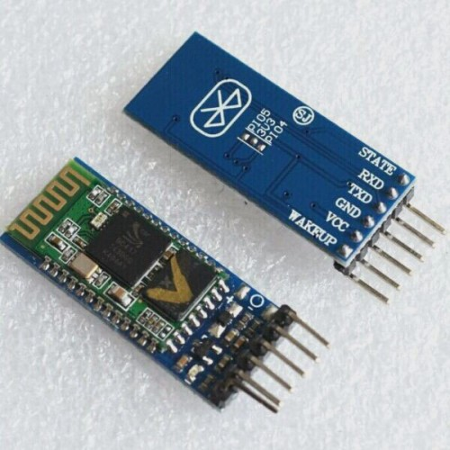

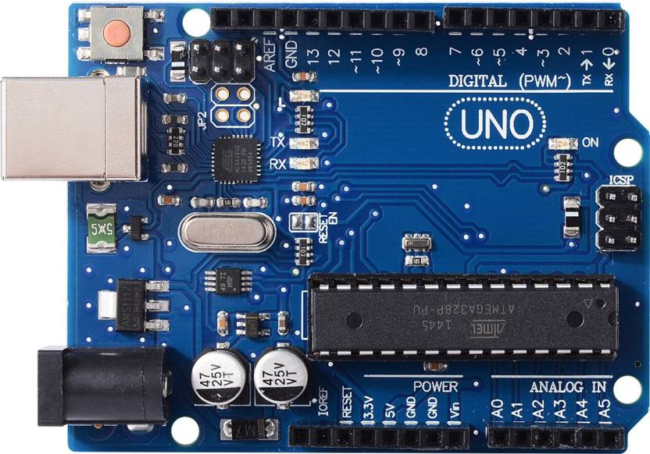
(Permanently Affiliated to University of Mumbai)
EQUIPMENTS USED:
Software:
Hardware:
Bluetooth HC-05
Arduino IDE
Arduino UNO

Slide 6
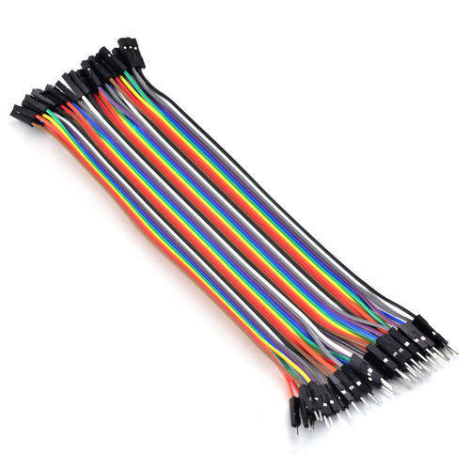
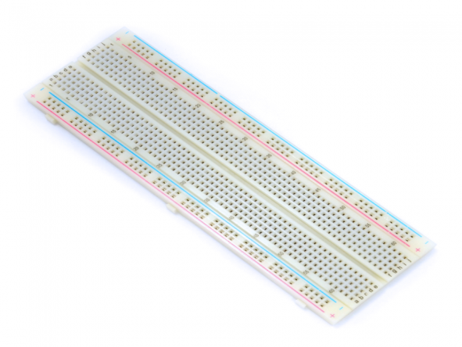
(Permanently Affiliated to University of Mumbai)
OTHER EQUIPMENTS USED:
Breadboard
Male to Female Jumper Wires

Slide 7
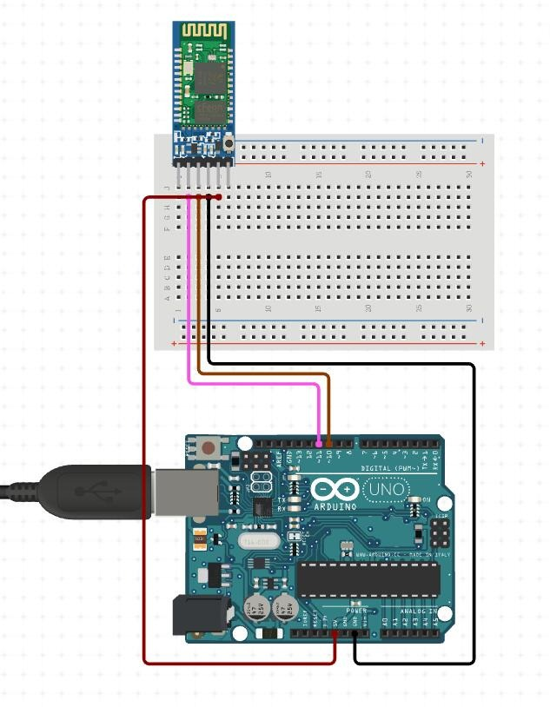
(Permanently Affiliated to University of Mumbai)
CIRCUIT DIAGRAM:

Slide 8
(Permanently Affiliated to University of Mumbai)
START
RANGE=R
YES
R<=10
NO
ALARM

Slide 9
(Permanently Affiliated to University of Mumbai)
TECHNICAL PROCEDURE
The proposed system consists of a micro-controller and a Bluetooth device that helps the person to use this system to track the child. It is also connected to a buzzer that activates on the alarm time to alert.
Once the Bluetooth is disconnected from parental device, the buzzer starts and it continues to ring until it is dismissed. This makes a person to get attention for sure. The below figure shows that the microcontroller controls the Bluetooth.
When the alarm time is set, and the alarm starts to ring, it increases the volume of the buzzer. This bluetooth device can be integrated with any other appliance to keep them in front eye for safety or even for home automation in future.

Slide 10
(Permanently Affiliated to University of Mumbai)
SCOPE FOR FUTURE USE
This product will last for a long period of time since it has Bluetooth embedded in it.
This Bluetooth can be used to connect parent and child devices is set directly through the user’s mobile phone.
Further in future this proposed application will also be upgraded so that it can even be used for home automation such to stay away from thief also it use as smart bag device.

Slide 11
(Permanently Affiliated to University of Mumbai)
CONCLUSION:
In conclusion, proposal was aimed to locate children and ensure the parents their child`s safety.
The solution proposed in this takes advantage of various features offered by Android smartphones.
Studying various existing works and papers have helped us to develop this project.
Hoping that this project helps the society to ensure the child`s safety, we have proposed this device. The proposed system will be implemented in later work.

Slide 12
(Permanently Affiliated to University of Mumbai)
Thank You!!!

